Slide 1







Lecture 11:
Request & Response Handling
Course - Web Development - III
-By
Pratik Raj Verma
welcome@krmangalam.edu.in
Sohna Road,Gurugram,Haryana 122103

Slide 2

| Table of Contents
Request-Response Cycle
Request Object (req)
Response Object (res)
References.
The End.

Slide 3

|
Have you ever wondered How does Instagram know which posts to show? How does the server understand what we want?

Slide 4
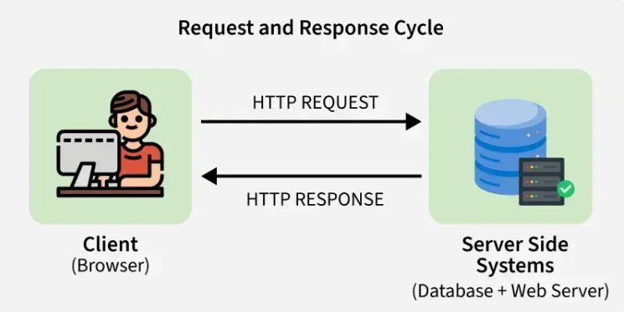
|
Have you ever wondered How does Instagram know which posts to show? How does the server understand what we want?
Whenever a user interacts with a website, communication happens between
Client ↔ Server
This communication follows a process called:
Request-Response Cycle

Slide 5
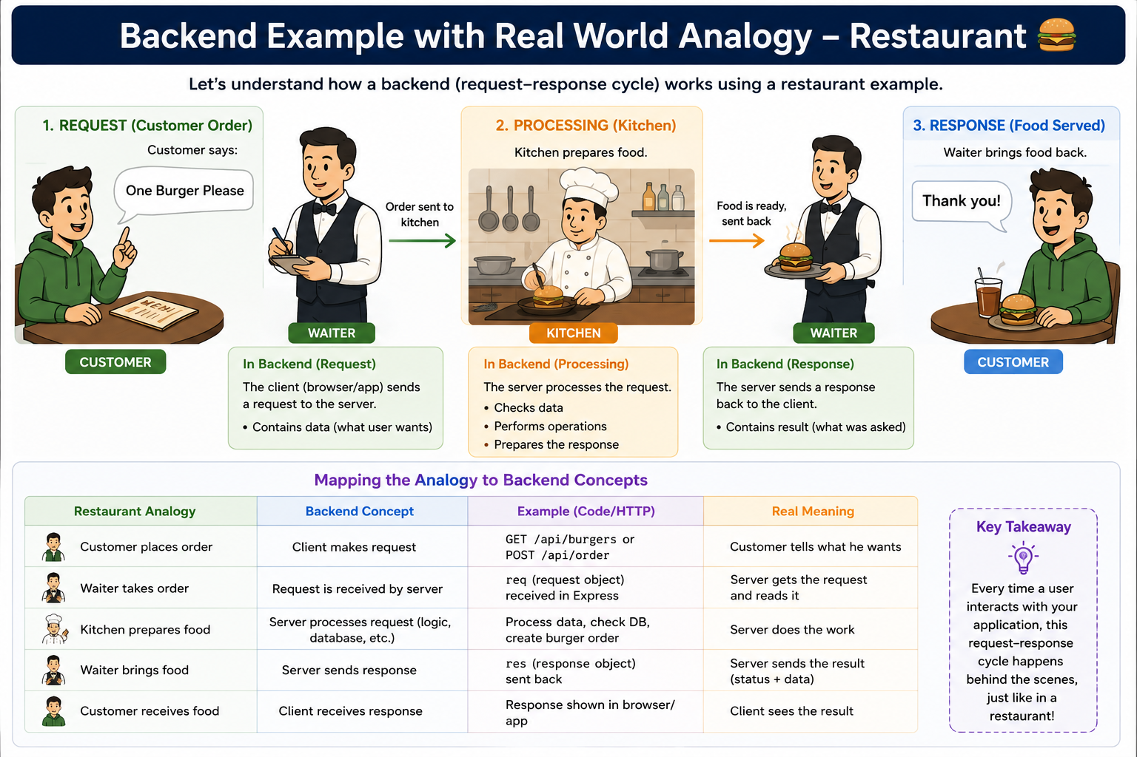
|
Request-Response Cycle

Slide 6
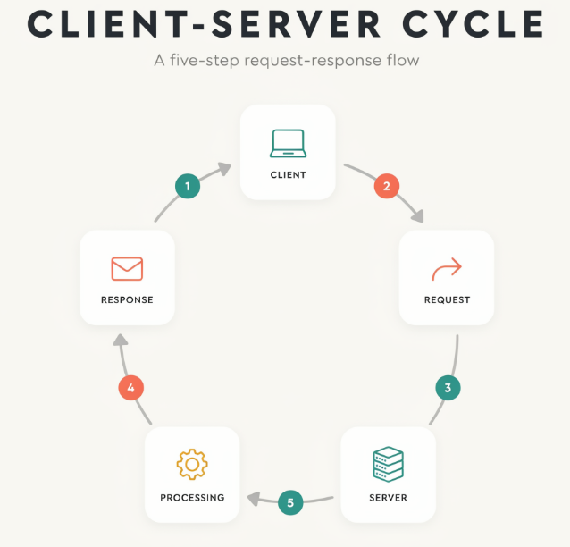
|
Request-Response Cycle
The Request-Response Cycle
Client: A user interacts with a device (like a web browser or mobile app).
Request: The client sends an HTTP request over the internet containing data, headers, and a specific URL action.
Server: A remote computer hosting the application receives the incoming network request.
Processing: The server executes backend code, validates data, and queries databases to build the requested information.
Response: The server packages the result (like HTML, JSON, or images) into an HTTP response.
Client: The user's device receives the response and renders the visual output on the screen. [1, 2, 3, 4, 5]

Slide 7
| Request Object (req)
A Request is a message sent by the client (browser, mobile app, or frontend) to the server asking for data or requesting an action. Whenever a user clicks a button, submits a form, or visits a webpage, a request is sent to the server.
Examples:
GET /students → Get all student data.
POST /students → Add a new student.
The client always starts the communication, and the server processes the request and sends back a response.

Slide 8
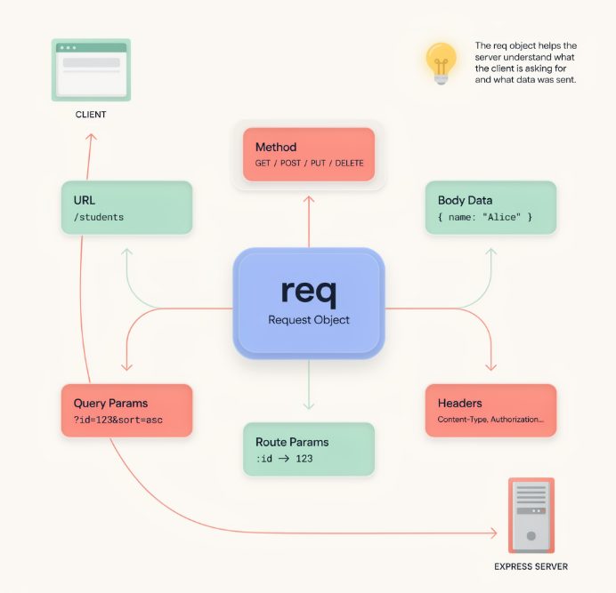
| Request Object (req)
Understanding Request Object (req)
Whenever a client sends a request to an Express server, Express automatically creates a Request Object (req). This object contains all the information related to the incoming request.
Using the req object, we can access details such as:
URL → The requested route (/students)
Method → Request type (GET, POST, PUT, DELETE)
Body Data → Data sent by the client
Query Parameters → Data passed in the URL query string
Route Parameters → Dynamic values in the URL
Headers → Additional request information
In simple words, the req object helps the server understand what the client is asking for and what data has been sent with the request.

Slide 9
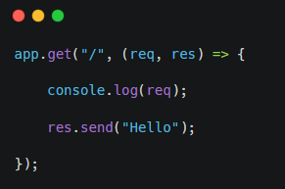
| Request Object (req)
Request Object Example
req : contains all information about the incoming request.

Slide 10
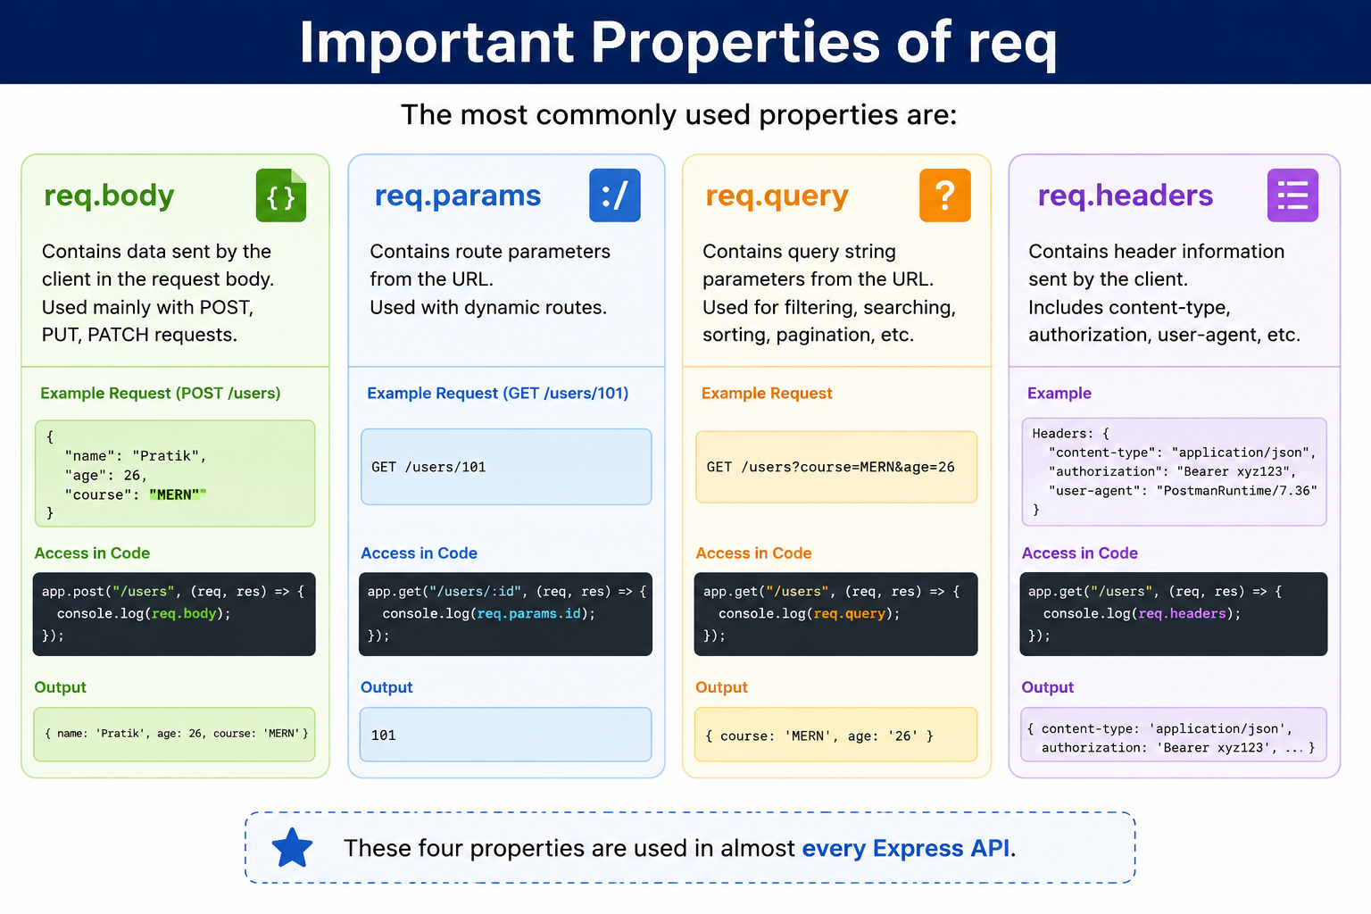
| Request Object (req)

Slide 11
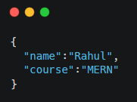
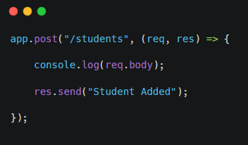
| Request Object (req)
Example Client Data:
req.body
The req.body property is used to receive data sent by the client in the request body. It is commonly used when creating, updating, or modifying data on the server.
req.body is mostly used with:
POST → Create new data
PUT → Update existing data
PATCH → Partially update data
Then Express stores this data inside req.body, allowing the server to access and process it easily.
req.body Example

Slide 12
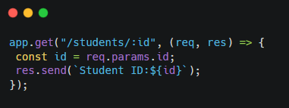
| Request Object (req)
req.params
The req.params object is used to access Route Parameters, which are dynamic values present inside the URL. Route parameters help us identify a specific resource, such as a student, product, or user.
Output: 101
Real World Example:
/students/101
/students/102
/students/103

Slide 13
| Request Object (req)
req.query
Query Parameters are values sent in the URL after the ? symbol.
They are used to send extra information to the server without changing the route.
Example URL: /students?course=MERN
Here:
/students → Route
course → Query Parameter Name (Key)
MERN → Query Parameter Value
Why do we use Query Parameters?
They are commonly used for:
Searching data Filtering data Sorting data Pagination

Slide 14
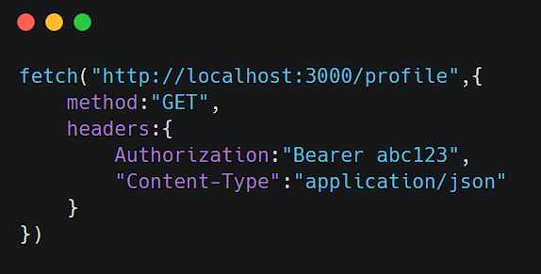
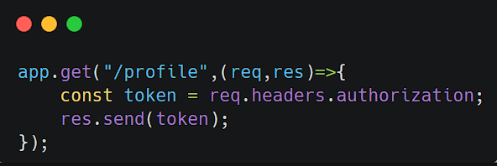
| Request Object (req)
req.headers
Headers contain additional information about requests.
Examples:
Authorization Token
Content-Type
Browser Information
Language Settings
Frontend Code
Used heavily in Authentication.
Backend Accessing Headers

Slide 15
| Response Object (res)
When a client sends a request to the server, the server processes it and sends something back.
The Response Object (res) is used to send that response back to the client.
Most Common Methods of Response Object :
res.send()
res.json()
res.status()

Slide 16
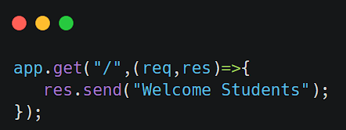
| Response Object (res)
res.send()
res.send() is used to send a response from the server back to the client.
When a client makes a request, the server processes it and uses res.send() to return data.
What Can res.send() Send?
1. Text Response
Response
Welcome Students

Slide 17
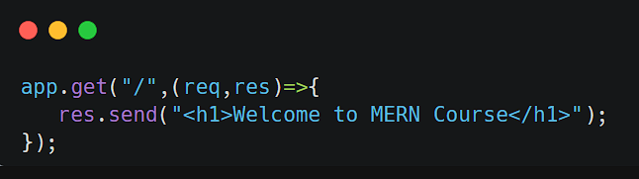
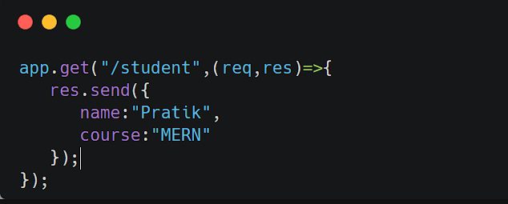
| Response Object (res)
What Can res.send() Send?
2. HTML Response
Browser Output
<h1>Welcome to MERN Course</h1>
3. Object Response
Response
{
"name":"Pratik",
"course":"MERN"
}

Slide 18
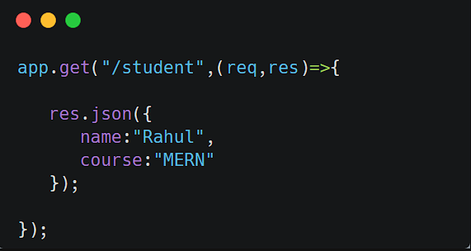
| Response Object (res)
res.json()
Used to send JSON data.
Industry standard API response format.
Why Use JSON?
JSON is:
Lightweight
Easy to Read
Easy to Parse
Industry Standard
Almost every API uses JSON.
Response:
{
"name":"Rahul",
"course":"MERN"
}

Slide 19
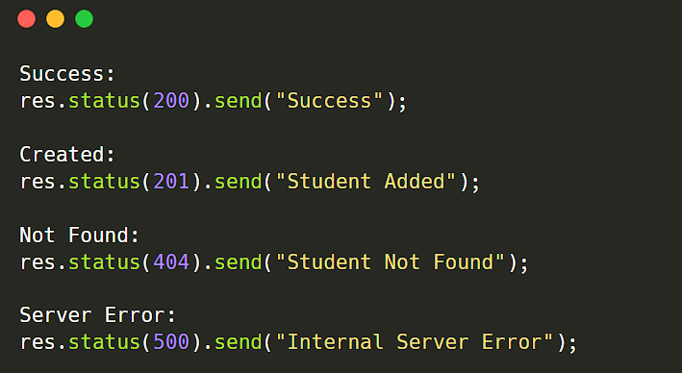
| Response Object (res)
res.status()
Status codes are used to inform the client about the result of a request, whether it was successful, failed, or encountered an error
successful
failed
unauthorized
not found
Examples : Used to send HTTP Status Codes.

Slide 20
| Response Object (res)
res.status()
Code | Meaning
200 | Success
201 | Created
400 | Bad Request
401 | Unauthorized
403 | Forbidden
404 | Not Found
500 | Internal Server Error

Slide 21

| Check Your Understanding
Question : What is the primary purpose of HTTP Status Codes?
Options : A. To create routes in Express.js
B. To send data to the database
C. To inform the client about the result of a request
D. To install Express.js
Answer : C. To inform the client about the result of a request
Explanation:
Status codes help the frontend understand whether the request was Successful, Failed, Unauthorized, not found

Slide 22
| Check Your Understanding
Question : Which Request Object property is used to receive data sent from the frontend in a
POST request?
Options : A. req.params
B. req.query
C. req.body
D. req.headers
Answer : C. req.body
Explanation:
req.body contains data sent by the client inside the request body.

Slide 23
| Check Your Understanding
Question : What is the difference between res.send() and res.json()?
Options : A. Both are exactly the same
B. res.send() starts the server and res.json() stops the server
C. res.send() can send text/data, while res.json() is specifically used to send JSON responses
D. res.json() receives data from frontend
Answer : C. res.send() can send text/data, while res.json() is specifically used to
send JSON responses
Explanation:
res.send("Hello World"); ====>>> Hello World
res.json({
name:"Rahul", ====>>>
course:"MERN"
});
{
"name":"Rahul",
"course":"MERN"
}

Slide 24
| References
MDN Web Docs : Comprehensive and official documentation for Express Js 🔗https://developer.mozilla.org/en-US/docs/Learn_web_development/Extensions/Server-side/Express_Nodejs
W3Schools : Beginner-friendly express tutorials with examples and interactive editors. 🔗https://www.w3schools.com/nodejs/nodejs_express.asp
Express Official- A comprehensive tutorial-style website that covers core Express JS concepts in depth.
🔗https://expressjs.com/en/

Slide 25
Thanks
For
Watching
Course - Web Development - III
welcome@krmangalam.edu.in
Sohna Road,Gurugram,Haryana 122103

